Slide 1

Healthcare and Clinics Moblie App for Patient self-service
Team Members Details
1.S.Raghuram Reddy– 2520090024
2.D.Nikhil Krishna – 2520090045
3.M.Prem Manikanta Reddy– 2520090045
II Year B.Tech-I Semester – CS&IT
Under the Guidance of
Dr.M Gayatri
Associate Professor
B.Tech II Year – I Sem | Dept of CS&IT | Project Review

Slide 2

Abstract
The Healthcare & Clinics Mobile App for Patient Self-Service is a digital healthcare solution developed to simplify and improve the way patients interact with hospitals, clinics, and healthcare professionals. The application provides patients with a convenient platform to access essential healthcare services through their smartphones without requiring frequent visits or phone calls to the clinic.
The app allows users to create and manage their profiles, search for doctors, check doctor availability, book and cancel appointments, receive appointment reminders, and view their upcoming and previous appointments. Patients can also access important medical information such as prescriptions, medical reports, diagnoses, and treatment history, depending on the services supported by the clinic. Notifications can be used to inform patients about appointments, medication schedules, reports, and other healthcare updates.
For healthcare providers, the system helps organize patient information and appointment schedules in a structured manner. Clinic staff can manage doctor availability, confirm or reschedule appointments, and maintain patient records more efficiently. This reduces paperwork, minimizes scheduling conflicts, and improves overall administrative efficiency.
Security and privacy are important components of the application because healthcare information is sensitive. The system can include secure login, authentication, role-based access, and protected storage of patient information. By combining patient self-service features with efficient clinic management, the application aims to improve accessibility, reduce waiting time, enhance communication, and provide a better healthcare experience for both patients and healthcare providers.
Overall, the Healthcare & Clinics Mobile App provides a simple, accessible, and efficient approach to healthcare management. It helps patients take greater control of their healthcare activities while enabling clinics to deliver services in a more organized and technology-driven manner.
B.Tech II Year – I Sem | Dept of Computational Intelligence| Application Development | Project Review

Slide 3
Introduction
Healthcare services are an essential part of everyday life, but patients often face difficulties such as long waiting times, manual appointment booking, repeated visits to clinics, and difficulty accessing medical information. Traditional healthcare management systems may also require patients to contact the clinic directly for simple services such as checking doctor availability or confirming appointment.
The Healthcare & Clinics Mobile App for Patient Self-Service is designed to solve these problems by providing healthcare services through a single mobile platform. Patients can create an account, manage their personal information, search for doctors, check availability, book appointments, receive reminders, and view their medical records and prescriptions.
The application also helps doctors and clinic staff manage appointments and patient information more efficiently. By reducing manual processes and improving communication, the system can save time for both patients and healthcare providers.
The main goal of this application is to provide a simple, convenient, secure, and user-friendly healthcare platform that allows patients to access essential services anytime and anywhere. It promotes better healthcare management and improves the overall patient experienc.
Overall, the Healthcare & Clinics Mobile App aims to make healthcare management more convenient and organized. It provides patients with greater control over their healthcare activities while helping healthcare providers improve their service efficiency and communication with patient
B.Tech II Year – I Sem | Dept of | Application Development | Project Review

Slide 4
Existing System
The existing healthcare system mainly depends on traditional methods such as visiting clinics directly, making phone calls, and maintaining physical records. Patients often need to contact the clinic to check doctor availability, book appointments, or obtain medical information.
Limitations of the Existing System
Patients may need to visit the clinic physically for basic services.
Appointment booking is often done through phone calls or reception staff.
Patients may experience long waiting times.
Doctor availability may not be easily visible to patients.
Medical records may be maintained using paper-based or separate systems.
Patients may have difficulty accessing their prescriptions and medical reports.
Appointment reminders may be limited or completely manual.
Managing a large number of patients can be time-consuming for clinic staff.
There may be a higher possibility of manual errors and scheduling conflicts.
Patients have limited 24/7 access to healthcare services.
B.Tech II Year – I Sem | Dept of | Application Development | Project Review

Slide 5
Proposed System
The proposed system is a mobile healthcare application that allows patients to easily access clinic services. It provides:
Online patient registration and login
Doctor search and appointment booking
Appointment reminders and notifications
Access to prescriptions and medical records
Doctor and clinic appointment management
Secure storage of patient information
B.Tech II Year – I Sem | Dept of | Application Development | Project Review

Slide 6
Methodology
Requirement Analysis
Identify the needs of patients, doctors, and clinic staff, such as registration, doctor search, appointment booking, and medical record access.
System Design
Design the mobile application interface and system architecture with separate modules for patients, doctors, and clinic staff.
User Registration & Authentication
Allow patients to create accounts and securely log in to access their healthcare information.
Doctor & Appointment Management
Patients can search for doctors, check availability, book or cancel appointments, while clinic staff can manage schedules.
Medical Records Management
Store and provide access to prescriptions, medical reports, diagnoses, and treatment history based on the services supported.
Notifications & Reminders
Send notifications for upcoming appointments, medication schedules, reports, and other healthcare updates.
Security Implementation
Protect sensitive healthcare information using secure authentication, role-based access, and protected data storage.
Testing & Deployment
Test all modules for functionality, usability, security, and reliability before deploying the application.
B.Tech II Year – I Sem | Dept of | Application Development | Project Review

Slide 7
Algorithms
User Login: Enter details → Validate → Login → Dashboard.
Doctor Search: Enter specialization → Search → Display doctors.
Appointment Booking: Select doctor → Check availability → Select slot → Confirm booking.
Medical Records: Login → Select records → Retrieve → Display.
Cancellation: Select appointment → Cancel → Update status → Notify patient.
Notifications: Check appointments → Generate reminder → Send notification.
Security: Login → Authenticate → Verify role → Allow authorized access.
B.Tech II Year – I Sem | Dept of | Application Development | Project Review

Slide 8
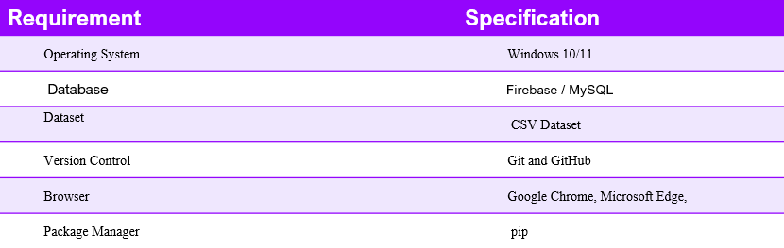
System requirements
B.Tech II Year – I Sem | Dept of | Application Development | Project Review

Slide 9
THANK YOU
B.Tech II Year – I Sem | Dept of | Application Development | Project Review

